Slide 1
GRADE 7 ACCELERATED · UNIT 5 · LESSONS 2–3
Scale Factor: Perimeter and Area
MA.7.GR.1.5
I can find the perimeter and the area of a scale copy from the original and k, and find k from two areas.
Grade 7 Accelerated · Unit 5 · Lessons 2–3 — Scale Factor: Perimeter and Area
1

Slide 2
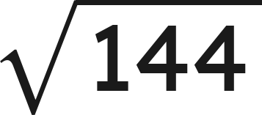
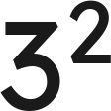
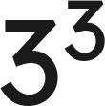
Warm-Up
1. A 20 cm side becomes 8 cm in the copy. Find the scale factor.
2. Find the value:
3. Find the values:
and
4. Find the perimeter and the area of a 3 cm by 5 cm rectangle.
Grade 7 Accelerated · Unit 5 · Lessons 2–3 — Scale Factor: Perimeter and Area
2

Slide 3
Warm-Up
1. A 20 cm side becomes 8 cm in the copy. Find the scale factor.
k = 0.4
2. Find the value:
12
3. Find the values:
and
9 and 27
4. Find the perimeter and the area of a 3 cm by 5 cm rectangle.
P = 16 cm, A = 15 cm²
Grade 7 Accelerated · Unit 5 · Lessons 2–3 — Scale Factor: Perimeter and Area
3

Slide 4
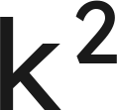

Vocabulary
k squared
, k times k: what an area is multiplied by when every length is multiplied
by
perimeter ratio
copy's perimeter ÷ original's perimeter — it equals
area ratio
copy's area ÷ original's area — it equals
Grade 7 Accelerated · Unit 5 · Lessons 2–3 — Scale Factor: Perimeter and Area
4

Slide 5
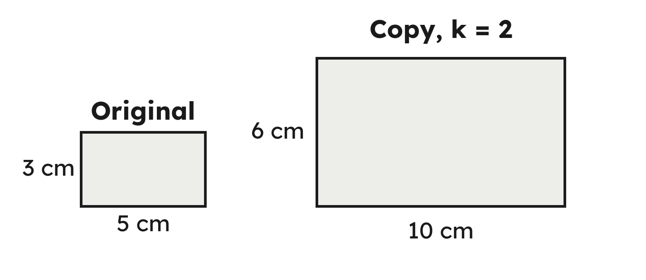
Notes
I. Every side × k, so the perimeter × k
Grade 7 Accelerated · Unit 5 · Lessons 2–3 — Scale Factor: Perimeter and Area
5

Slide 6
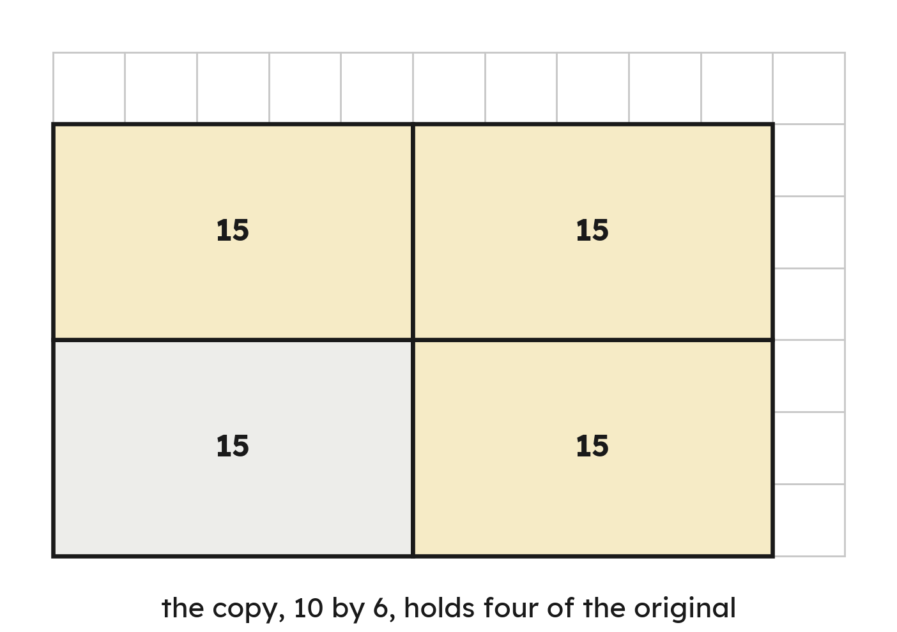
Notes
II. Area is two lengths, so the area × k × k
Grade 7 Accelerated · Unit 5 · Lessons 2–3 — Scale Factor: Perimeter and Area
6

Slide 7
Notes
III. From two areas back to k: a square root
Area ratio = k². k = the square root of the area ratio.
Grade 7 Accelerated · Unit 5 · Lessons 2–3 — Scale Factor: Perimeter and Area
7

Slide 8

Example 1
A 2 cm by 4 cm rectangle is scaled by
.
Find the copy's perimeter and area.
Grade 7 Accelerated · Unit 5 · Lessons 2–3 — Scale Factor: Perimeter and Area
8

Slide 9
Example 1
Answer: P = 36 cm, A = 72 cm²
Grade 7 Accelerated · Unit 5 · Lessons 2–3 — Scale Factor: Perimeter and Area
9

Slide 10

Your Turn
A 3 cm by 6 cm rectangle is scaled by
.
Find the copy's perimeter and area.
Grade 7 Accelerated · Unit 5 · Lessons 2–3 — Scale Factor: Perimeter and Area
10

Slide 11


Your Turn
A 3 cm by 6 cm rectangle is scaled by
.
Find the copy's perimeter and area.
Answer: P = 72 cm, A = 288 cm²
Grade 7 Accelerated · Unit 5 · Lessons 2–3 — Scale Factor: Perimeter and Area
11

Slide 12
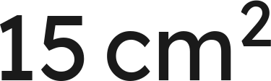
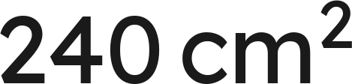
Example 2
A figure has area
.
Its scale copy has area
.
A side of the original is 3 cm.
Find k, then the matching side of the copy.
Grade 7 Accelerated · Unit 5 · Lessons 2–3 — Scale Factor: Perimeter and Area
12

Slide 13
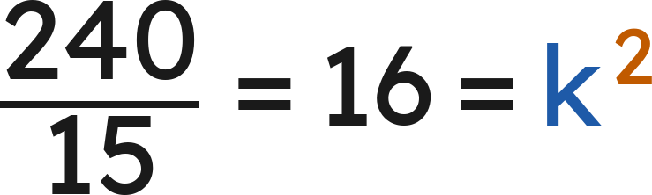
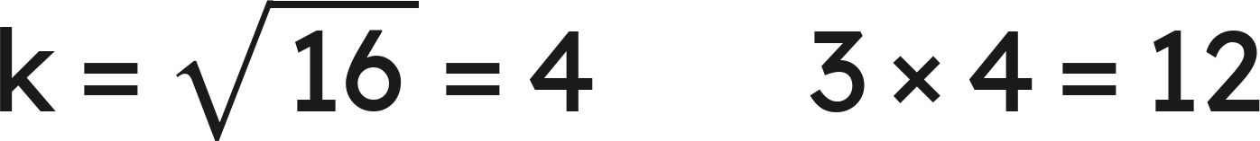
Example 2
Answer: k = 4; the side is 12 cm
Grade 7 Accelerated · Unit 5 · Lessons 2–3 — Scale Factor: Perimeter and Area
13

Slide 14
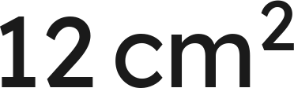
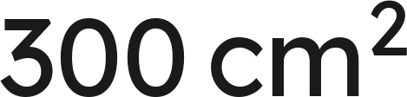
Your Turn
A figure has area
.
Its scale copy has area
.
A side of the original is 2 cm.
Find
, then the matching side of the copy.
Grade 7 Accelerated · Unit 5 · Lessons 2–3 — Scale Factor: Perimeter and Area
14

Slide 15


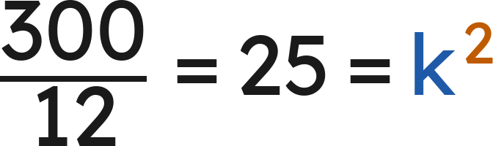
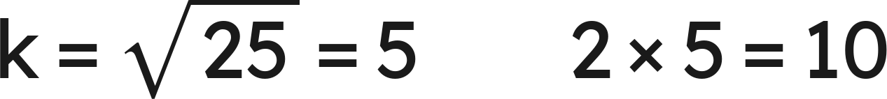
Your Turn
A figure has area
.
Its scale copy has area
.
A side of the original is 2 cm.
Find
, then the matching side of the copy.
Answer: k = 5; the side is 10 cm
Grade 7 Accelerated · Unit 5 · Lessons 2–3 — Scale Factor: Perimeter and Area
15

Slide 16

Whiteboards · Question 1 of 9
A figure with perimeter 14 cm is scaled by
.
What is the copy's perimeter?
Answer it.
Grade 7 Accelerated · Unit 5 · Lessons 2–3 — Scale Factor: Perimeter and Area
16

Slide 17


Whiteboards · Question 1 of 9
A figure with perimeter 14 cm is scaled by
.
What is the copy's perimeter?
Answer: 28 cm
Grade 7 Accelerated · Unit 5 · Lessons 2–3 — Scale Factor: Perimeter and Area
17

Slide 18
Whiteboards · Question 2 of 9
A figure with area
is scaled by
.
What is the copy's area?
Answer it.
Grade 7 Accelerated · Unit 5 · Lessons 2–3 — Scale Factor: Perimeter and Area
18

Slide 19

Whiteboards · Question 2 of 9
A figure with area
is scaled by
.
What is the copy's area?
Answer: 48 cm²
Grade 7 Accelerated · Unit 5 · Lessons 2–3 — Scale Factor: Perimeter and Area
19

Slide 20
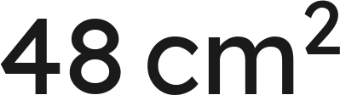
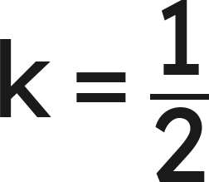
Whiteboards · Question 3 of 9
A figure with area
is scaled by
.
What is the copy's area?
Answer it.
Grade 7 Accelerated · Unit 5 · Lessons 2–3 — Scale Factor: Perimeter and Area
20

Slide 21

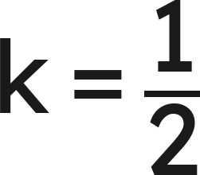
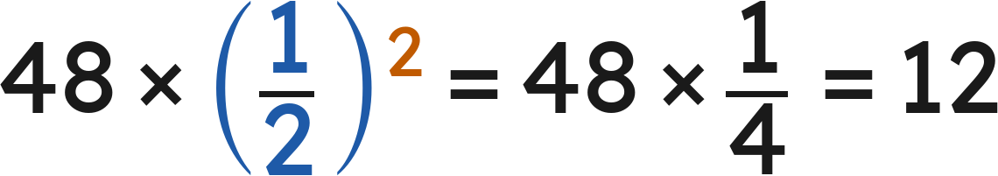
Whiteboards · Question 3 of 9
A figure with area
is scaled by
.
What is the copy's area?
Answer: 12 cm²
Grade 7 Accelerated · Unit 5 · Lessons 2–3 — Scale Factor: Perimeter and Area
21

Slide 22





Whiteboards · Question 4 of 9
A figure with area
is scaled by
.
What is the copy's area?
A.
B.
C.
D.
Answer it.
Grade 7 Accelerated · Unit 5 · Lessons 2–3 — Scale Factor: Perimeter and Area
22

Slide 23



Whiteboards · Question 4 of 9
A figure with area
is scaled by
.
What is the copy's area?
Answer: A — 90 cm²
Grade 7 Accelerated · Unit 5 · Lessons 2–3 — Scale Factor: Perimeter and Area
23

Slide 24
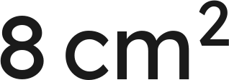

Whiteboards · Question 5 of 9
A figure with area
is scaled by
.
What is the copy's area?
Answer it.
Grade 7 Accelerated · Unit 5 · Lessons 2–3 — Scale Factor: Perimeter and Area
24

Slide 25


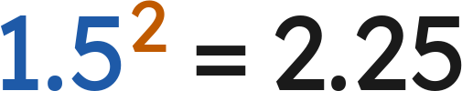

Whiteboards · Question 5 of 9
A figure with area
is scaled by
.
What is the copy's area?
Answer: 18 cm²
Grade 7 Accelerated · Unit 5 · Lessons 2–3 — Scale Factor: Perimeter and Area
25

Slide 26




Whiteboards · Question 6 of 9
A figure's perimeter is 20 cm; its copy's perimeter is 60 cm.
What is the area ratio, copy to original?
A.
B.
C.
D.
Answer it.
Grade 7 Accelerated · Unit 5 · Lessons 2–3 — Scale Factor: Perimeter and Area
26

Slide 27
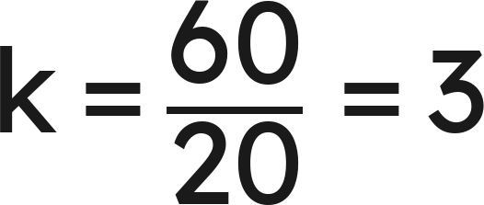
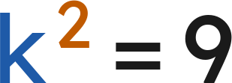
Whiteboards · Question 6 of 9
A figure's perimeter is 20 cm; its copy's perimeter is 60 cm.
What is the area ratio, copy to original?
: the perimeter ratio is k
: the area ratio
Answer: D — 9
Grade 7 Accelerated · Unit 5 · Lessons 2–3 — Scale Factor: Perimeter and Area
27

Slide 28
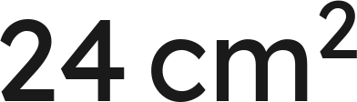
Whiteboards · Question 7 of 9
A triangle with sides 6, 8 and 10 cm is scaled by
.
Its area is
.
Find the copy's perimeter and area.
Answer it.
Grade 7 Accelerated · Unit 5 · Lessons 2–3 — Scale Factor: Perimeter and Area
28

Slide 29

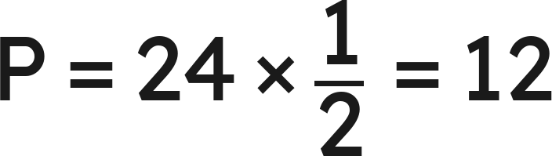
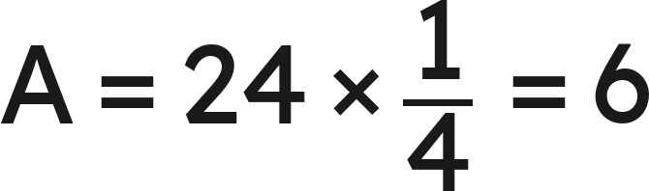
Whiteboards · Question 7 of 9
A triangle with sides 6, 8 and 10 cm is scaled by
.
Its area is
.
Find the copy's perimeter and area.
Answer: P = 12 cm, A = 6 cm²
Grade 7 Accelerated · Unit 5 · Lessons 2–3 — Scale Factor: Perimeter and Area
29

Slide 30

Whiteboards · Question 8 of 9
A 4 in by 6 in photo, taken 3 years ago, is enlarged at
.
What is the enlargement's area?
Answer it.
Grade 7 Accelerated · Unit 5 · Lessons 2–3 — Scale Factor: Perimeter and Area
30

Slide 31


Whiteboards · Question 8 of 9
A 4 in by 6 in photo, taken 3 years ago, is enlarged at
.
What is the enlargement's area?
Answer: 150 in²
Grade 7 Accelerated · Unit 5 · Lessons 2–3 — Scale Factor: Perimeter and Area
31

Slide 32
Whiteboards · Question 9 of 9
Jo says that doubling every side of a rectangle doubles its area.
Explain why not, with a counterexample.
Write your answer in sentences.
Grade 7 Accelerated · Unit 5 · Lessons 2–3 — Scale Factor: Perimeter and Area
32

Slide 33
Whiteboards · Question 9 of 9
Jo says that doubling every side of a rectangle doubles its area.
Explain why not, with a counterexample.
Answer: No: 2 by 7 doubled is 4 by 14, area 14 → 56 — × 4, as both lengths doubled.
Grade 7 Accelerated · Unit 5 · Lessons 2–3 — Scale Factor: Perimeter and Area
33

Slide 34



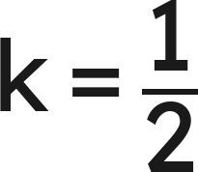




Independent Set
1.
A figure with perimeter 18 cm is scaled by
. Find the copy's perimeter.
2.
A figure with area
is scaled by
. Find the copy's area.
3.
A figure with area
is scaled by
. Find the copy's area.
4.
A 2 cm by 5 cm rectangle is scaled by
. Find the copy's perimeter
and area.
5.
A figure has area
and its scale copy has area
. Find
.
6.
A figure's perimeter is 12 cm and its copy's perimeter is 48 cm. What is the
area ratio, copy to original?
Grade 7 Accelerated · Unit 5 · Lessons 2–3 — Scale Factor: Perimeter and Area
34

Slide 35
IXL
1.
Open IXL and start today's skills.
2.
Work on paper where the question needs work. The answer box does not show it.
3.
Every skill listed is required, to a SmartScore of 67. Due by the Unit 5 test.
Today's skills — all required
Perimeter and area: changes in scale — ZC6
Scale drawings: find the scale factor or missing side — XHM
Grade 7 Accelerated · Unit 5 · Lessons 2–3 — Scale Factor: Perimeter and Area
35

